Slide 1
Introduction to NoSQL

Slide 2
What is NoSQL?
NoSQL is a non-relational DMS, that does not require a fixed schema, avoids joins, and is easy to scale.
NoSQL database is used for distributed data stores with humongous data storage needs.
NoSQL is used for Big data and real-time web apps.
For example, companies like Twitter, Facebook, Google that collect terabytes of user data every single day.

Slide 3
Traditional RDBMS uses SQL syntax to store and retrieve data for further insights. Instead, a NoSQL database system encompasses a wide range of database technologies that can store structured, semi-structured, unstructured and polymorphic data.

Slide 4
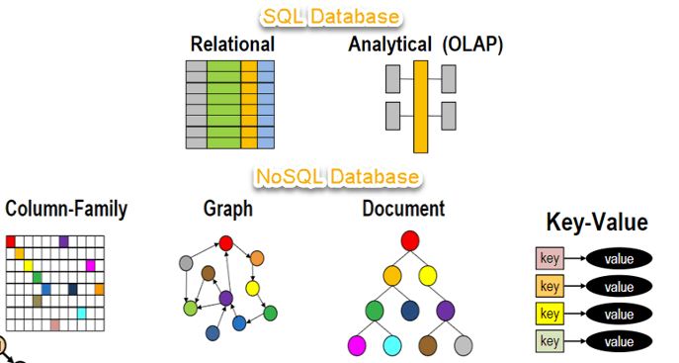

Slide 5
Why NoSQL?
The concept of NoSQL databases became popular with Internet giants like Google, Facebook, Amazon, etc. who deal with huge volumes of data.
The system response time becomes slow when you use RDBMS for massive volumes of data.
To resolve this problem, we could "scale up" our systems by upgrading our existing hardware. This process is expensive.
The alternative for this issue is to distribute database load on multiple hosts whenever the load increases. This method is known as "scaling out."

Slide 6
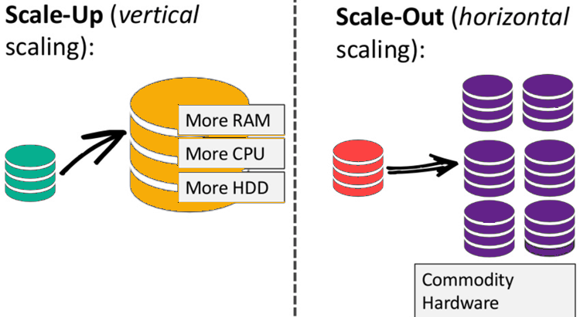

Slide 7
Features of NoSQL
Non-relational
NoSQL databases never follow the relational model
Never provide tables with flat fixed-column records
Work with self-contained aggregates or BLOBs
Doesn't require object-relational mapping and data normalization
No complex features like query languages, query planners,referential integrity joins, ACID
Schema-free
NoSQL databases are either schema-free or have relaxed schemas
Do not require any sort of definition of the schema of the data
Offers heterogeneous structures of data in the same domain

Slide 8
Simple API
Offers easy to use interfaces for storage and querying data provided
APIs allow low-level data manipulation & selection methods
Text-based protocols mostly used with HTTP REST with JSON
Mostly used no standard based query language
Web-enabled databases running as internet-facing services

